Slide 1
Melbourne/Victorian Crime data analysis
By Hiu Kwan Lai, Nicholas Chatjaval, Vishaan Solanki

Slide 2
Aim
To identify the top criminal offences by Local government area and suburbs over the last 5 years.
Finding the top 10 most common offences in Victoria
The top offences based on gender.
The top offences based on age, focus on youth offenders.
We seeked to find trends and patterns for groups in youth offenders.

Slide 3
What is the problem?
Which localities and suburbs are more dangerous to reside in due to crime rate?
What impact did the COVID-19 pandemic have on crime rates?
What type of crimes are being committed based on gender?
How has youth offence trended over the years? What is the most common youth offence?

Slide 4
Key Stakeholders
Parents
Schools
Residents across Victoria
Local councils and policy makers
State governments implementing restrictions during pandemic
People thinking about moving to/within Victoria

Slide 5
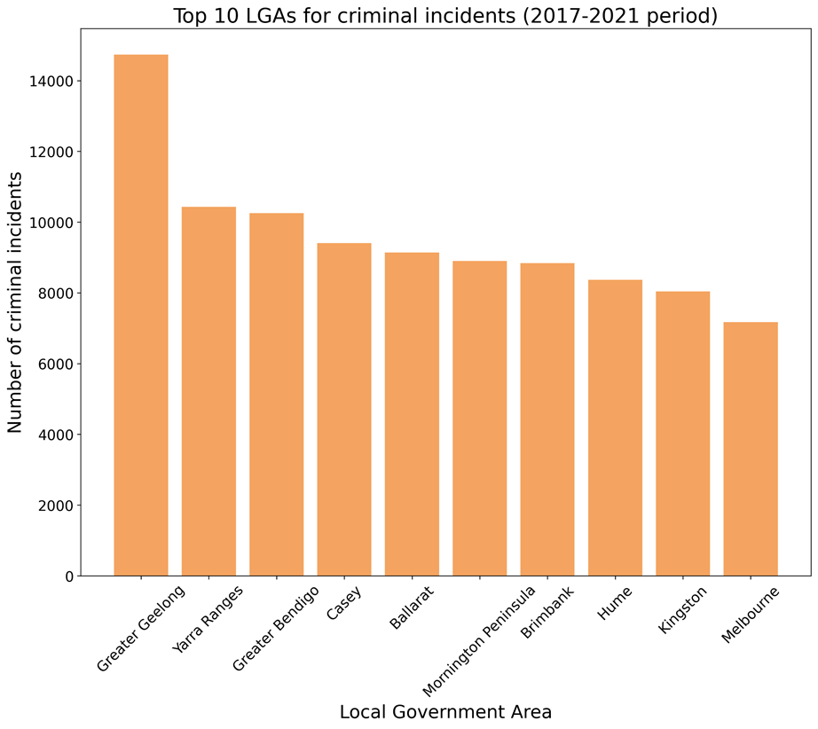
LGA Key Findings
5 year data from 2017 - 2021
Local government area
Figures are impacted by population size within each LGA demographic.

Slide 6
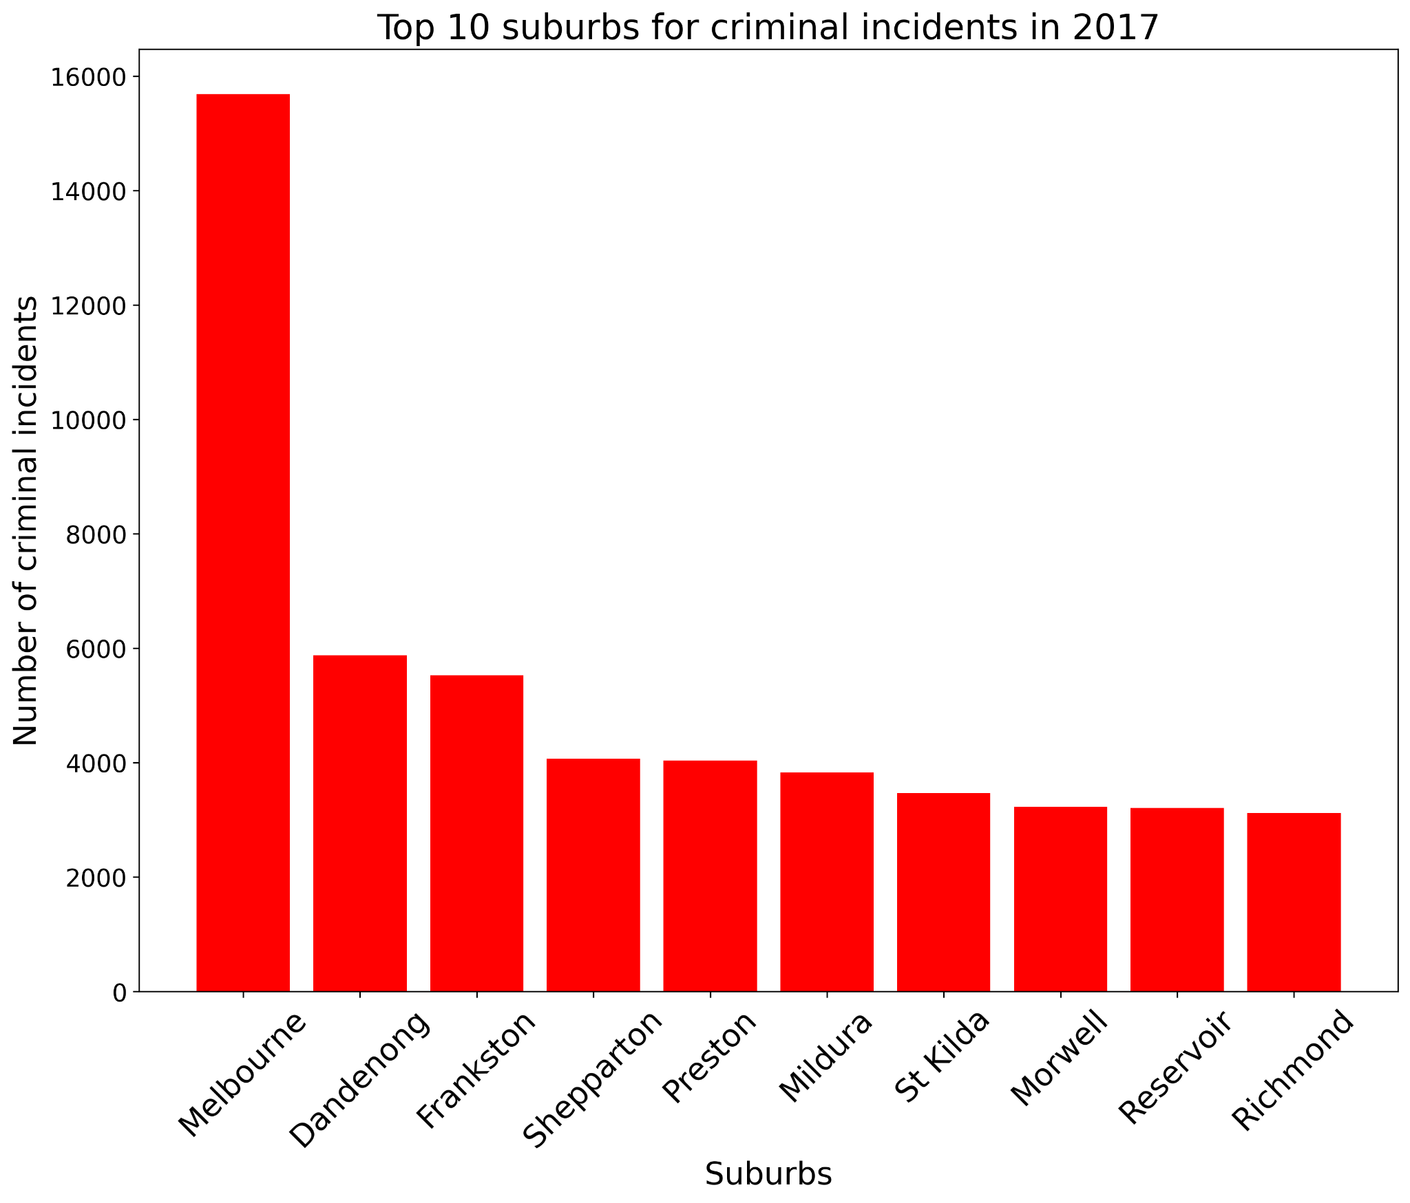
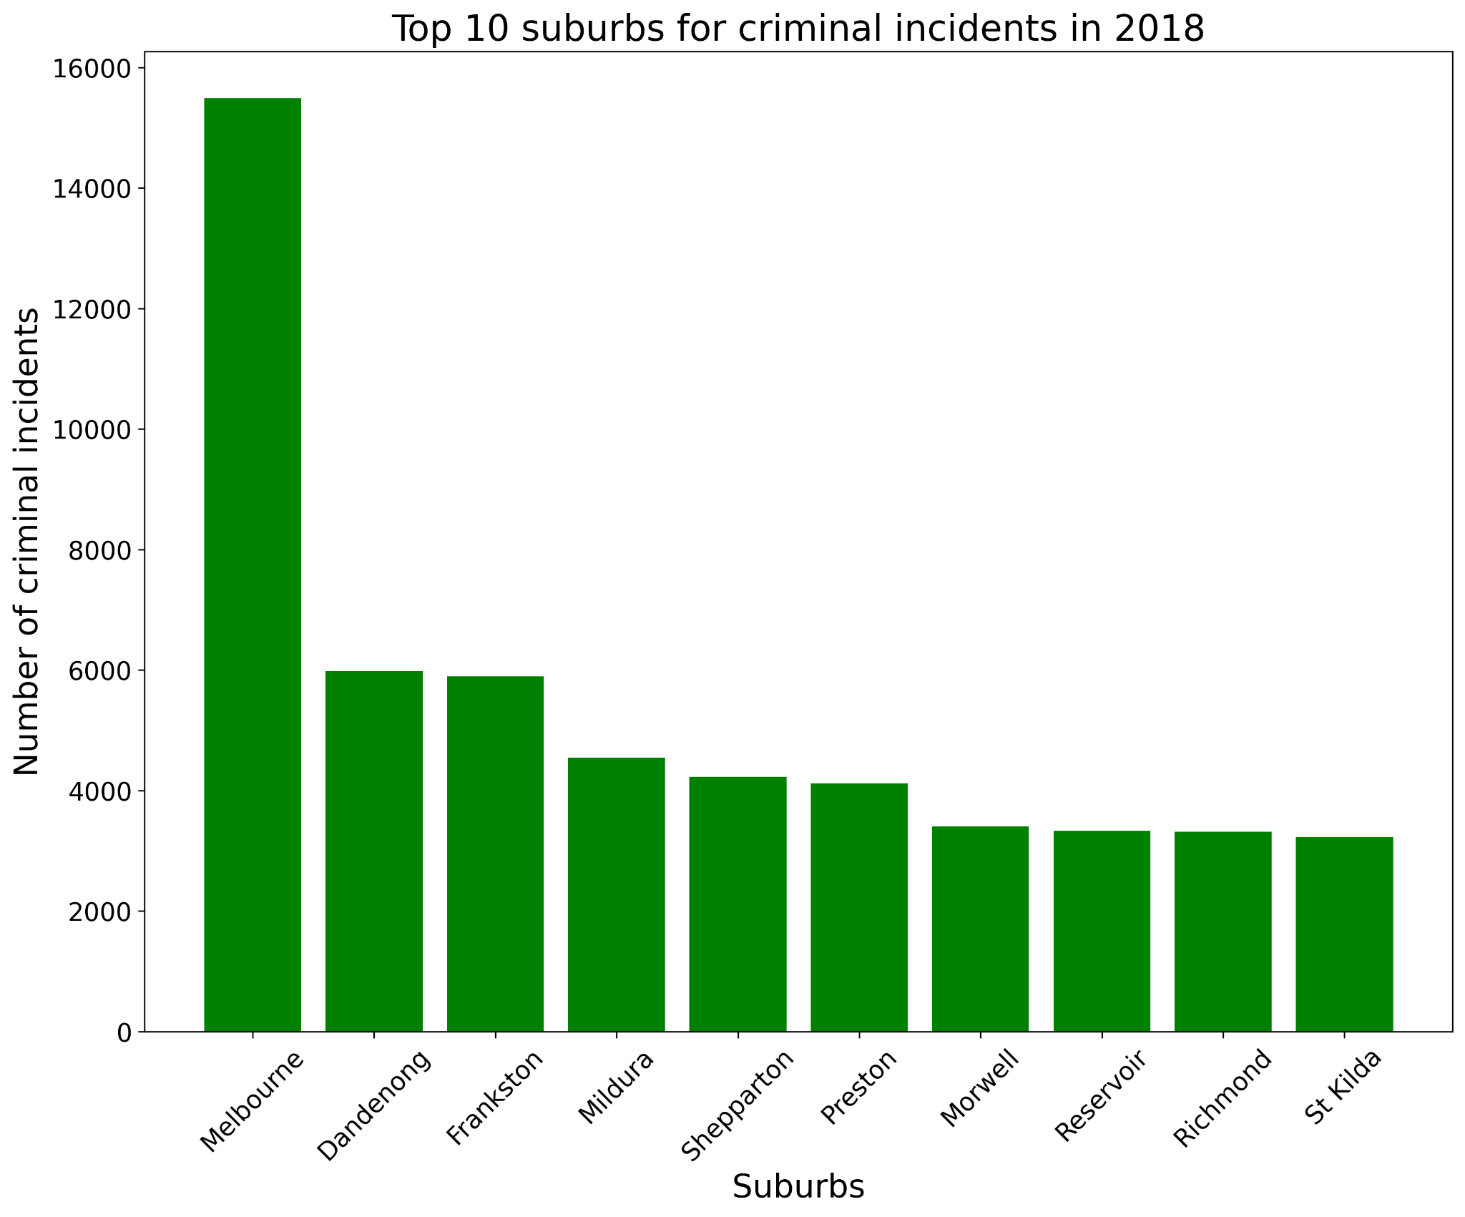
Suburban Key Findings in Victoria (2017- 2018)

Slide 7
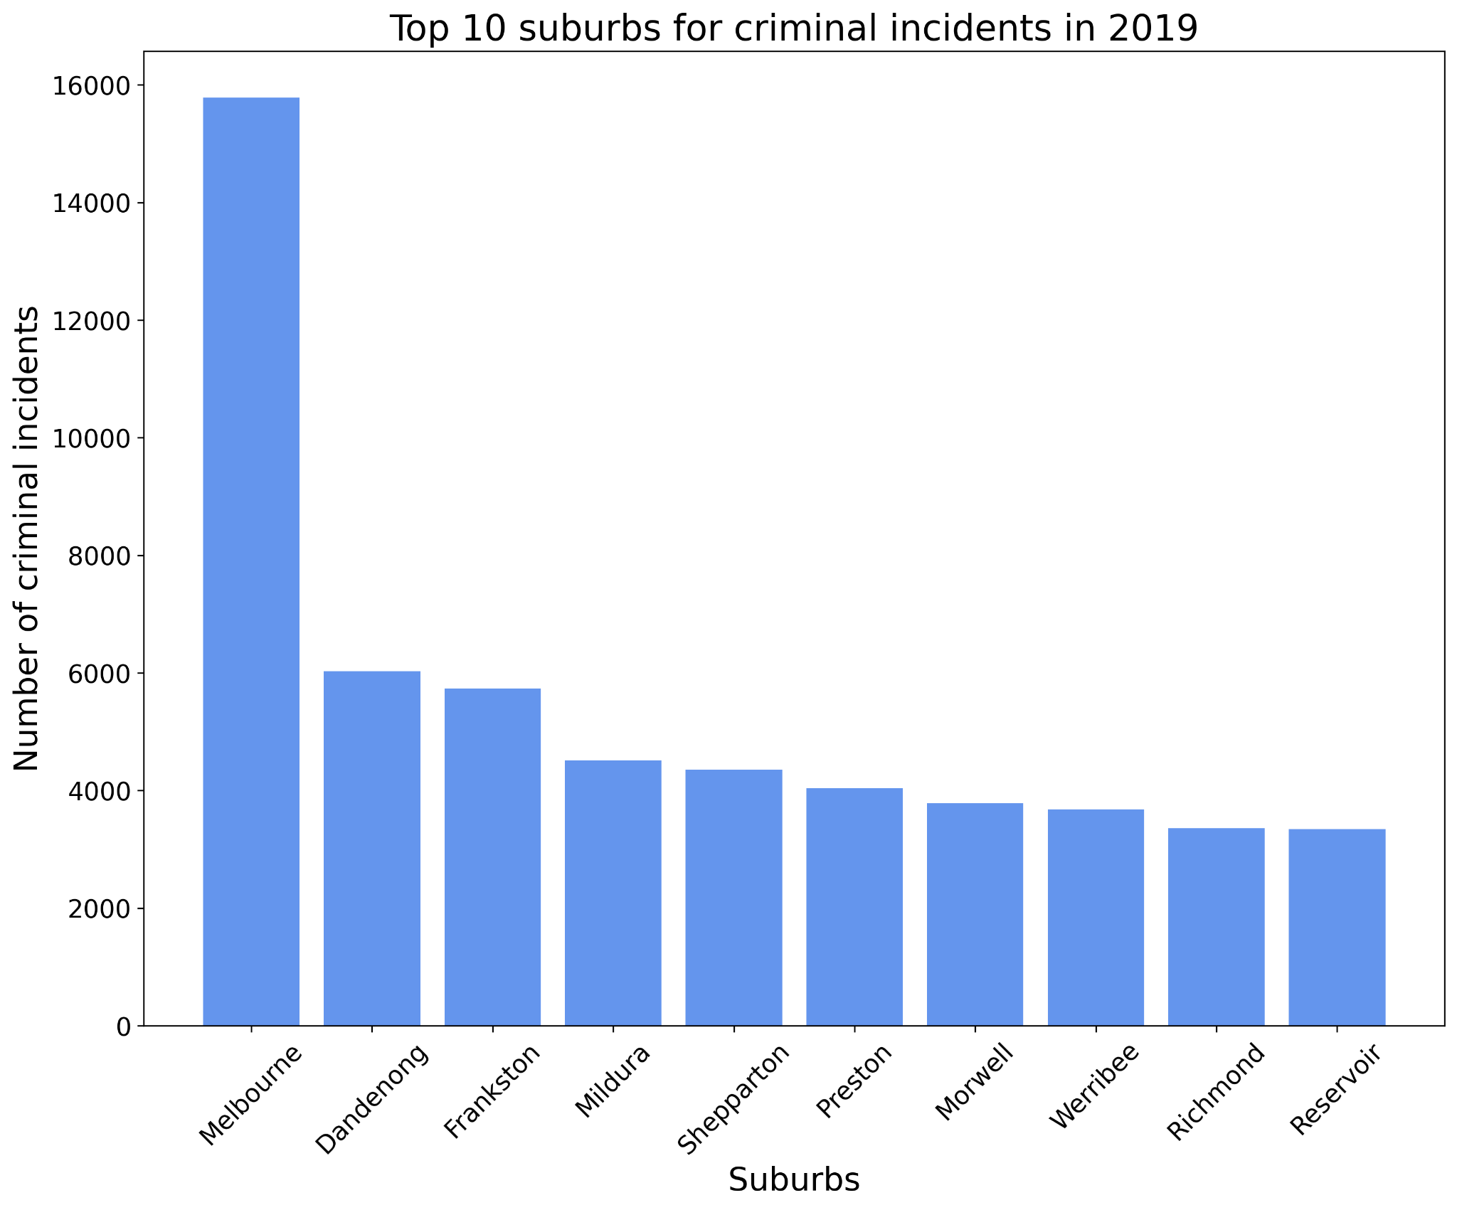
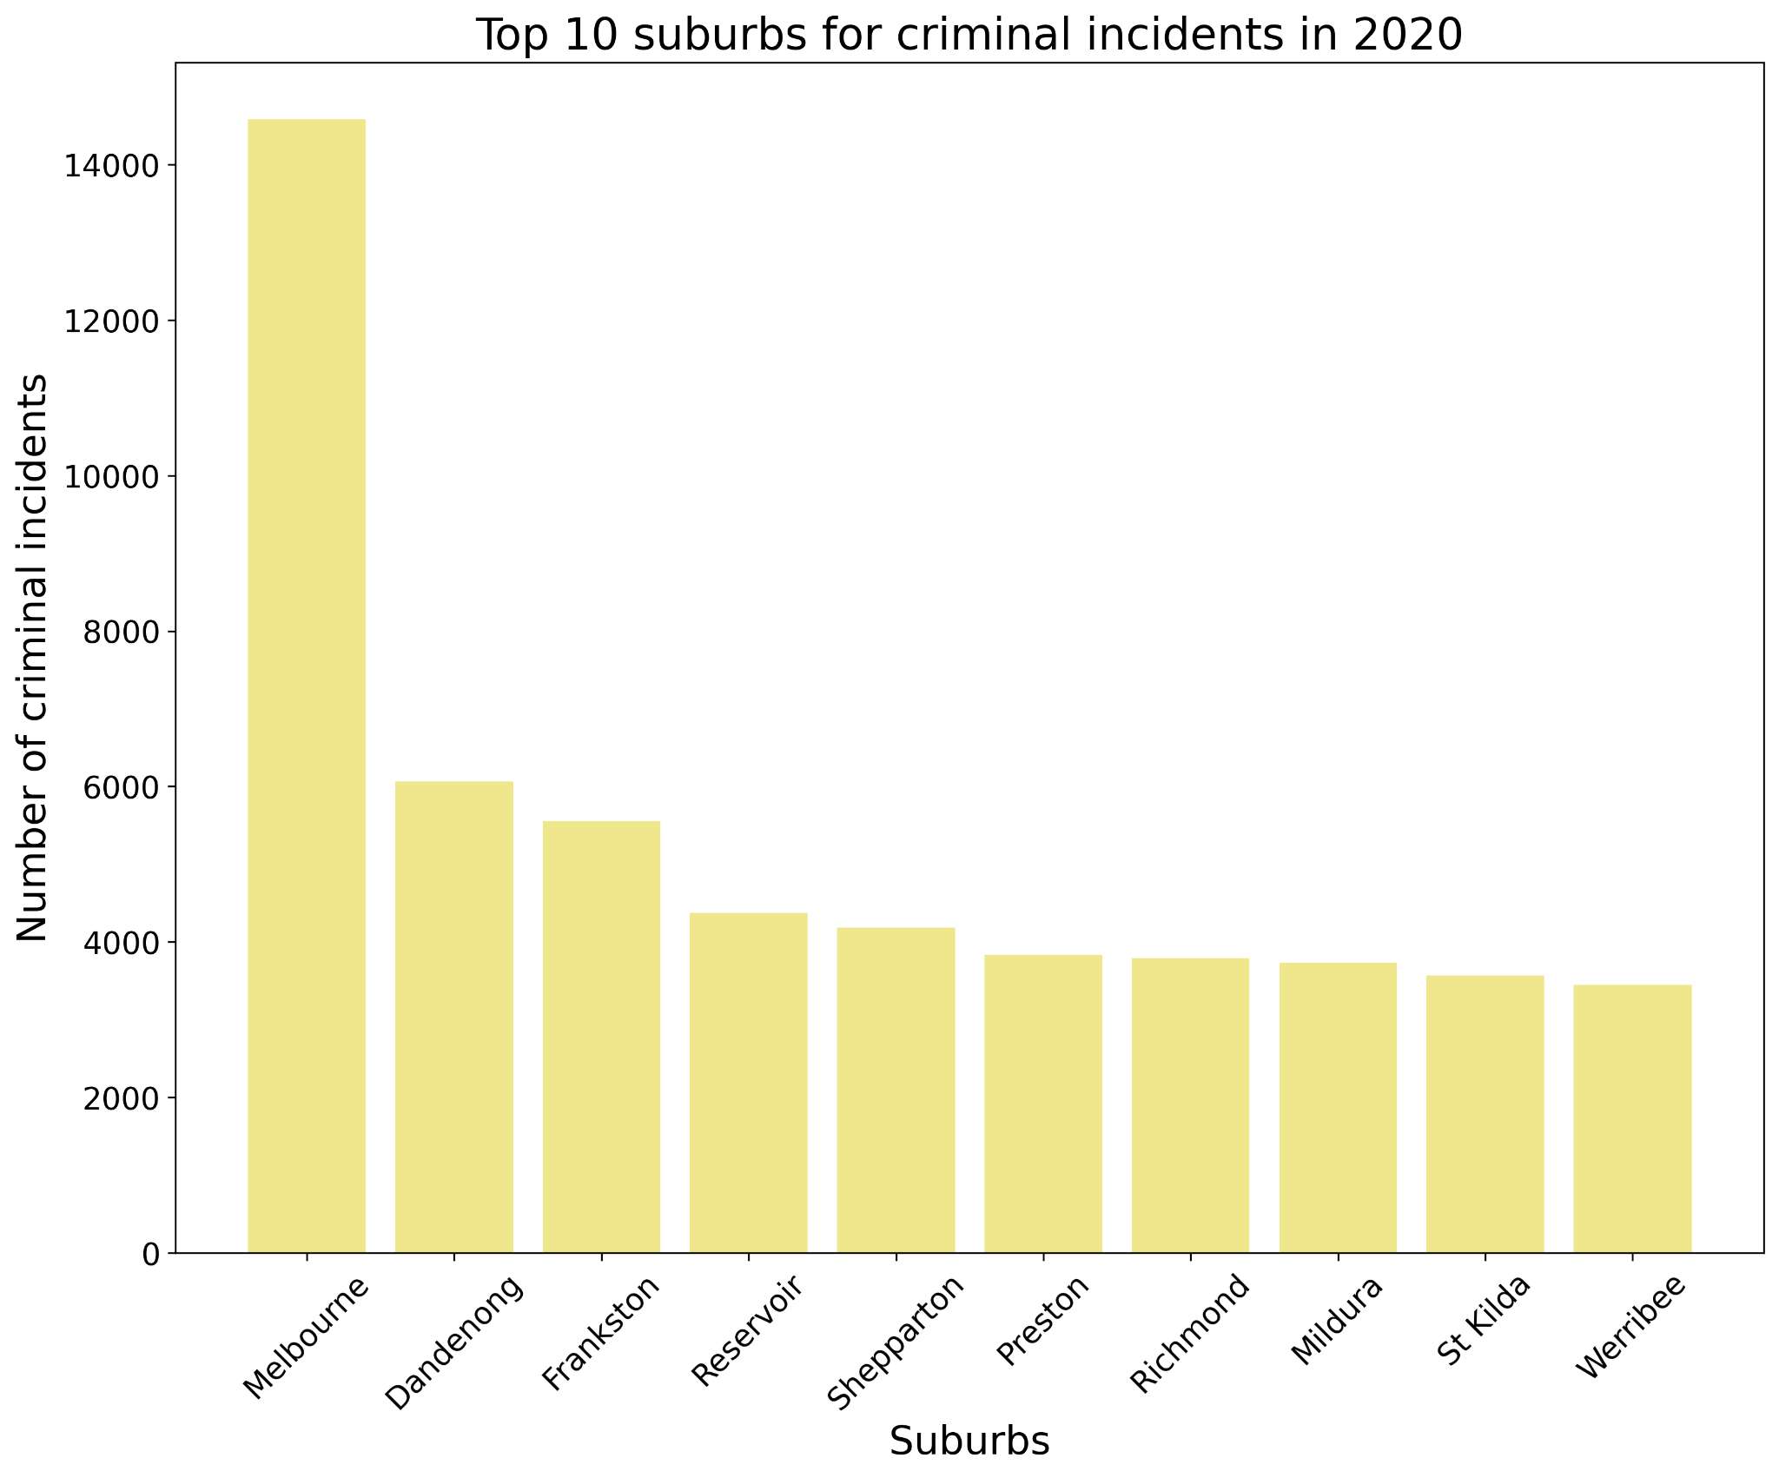
Suburban Key Findings in Victoria (2019 - 2020)

Slide 8
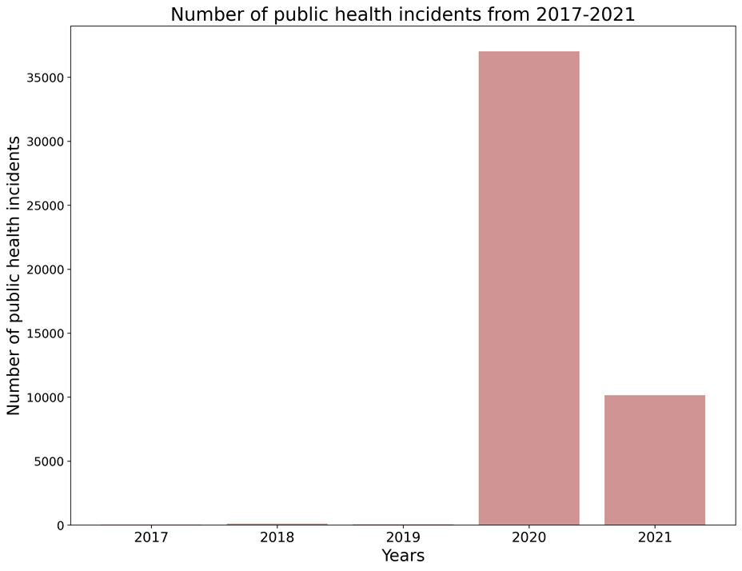
Public Health Crimes Victoria 2017- 2021
Less than 200 incidents related to public health before pandemic.
Public health crimes are usually very low.
An example of a public health crime:
“Failure to comply with directives relating to the COVID-19 pandemic under state or territory Public Health Acts, such as being more than 5km from home at times in Victoria” (Source: “https://www.dhhs.vic.gov.au/coronavirus”)

Slide 9
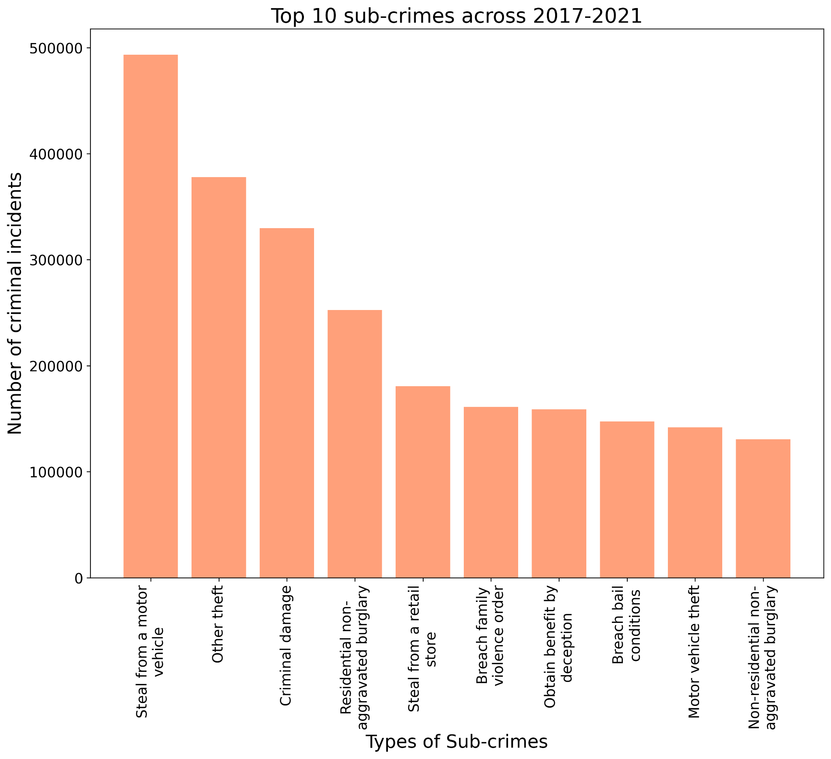
Sub Crimes Victoria 2017- 2021
Motor vehicle theft Criminal damage Property & deception Family violence assaults/threats Breaches of family violence orders Receiving/handling stolen goods Cause property damage by fire Thefts of motor bikes/bicycles

Slide 10
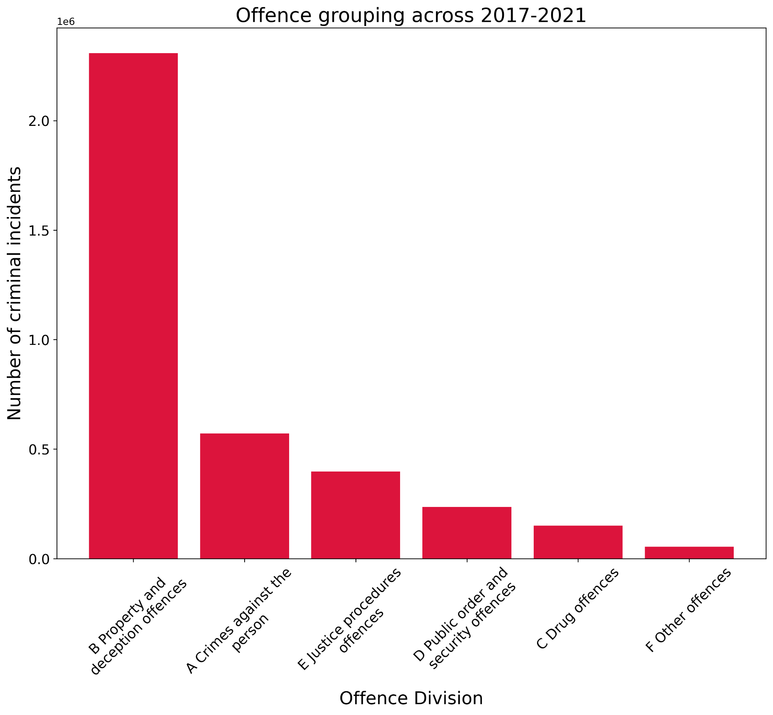
Divisions of crimes in Victoria 2017- 2021
The most common type of crime recorded across Victoria was property and deception offences:
Property damage
Arson
Burglary
Deception
Bribery
All related crimes towards family violence (Crimes against the person) and breaches of orders related to family violence get recognised in (Justice procedure offences)

Slide 11
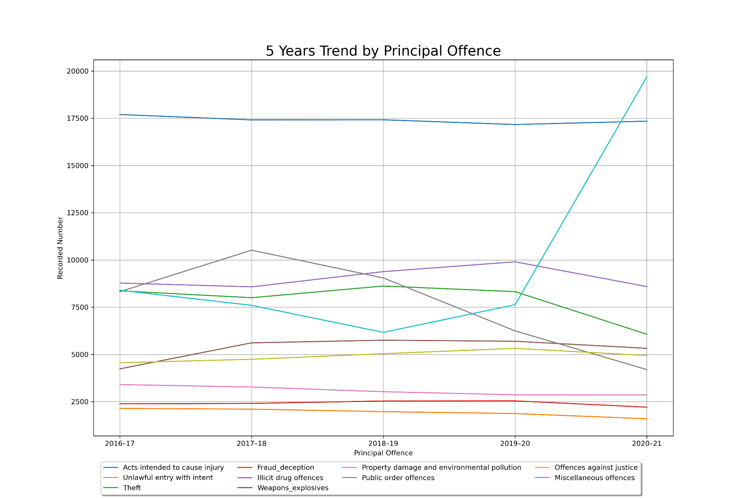
5 Years Trend by Principal offence
Key findings:
Miscellaneous offence jumped 6% (largely due to covid)
All other offence shows a steady decline over the last 5 years

Slide 12
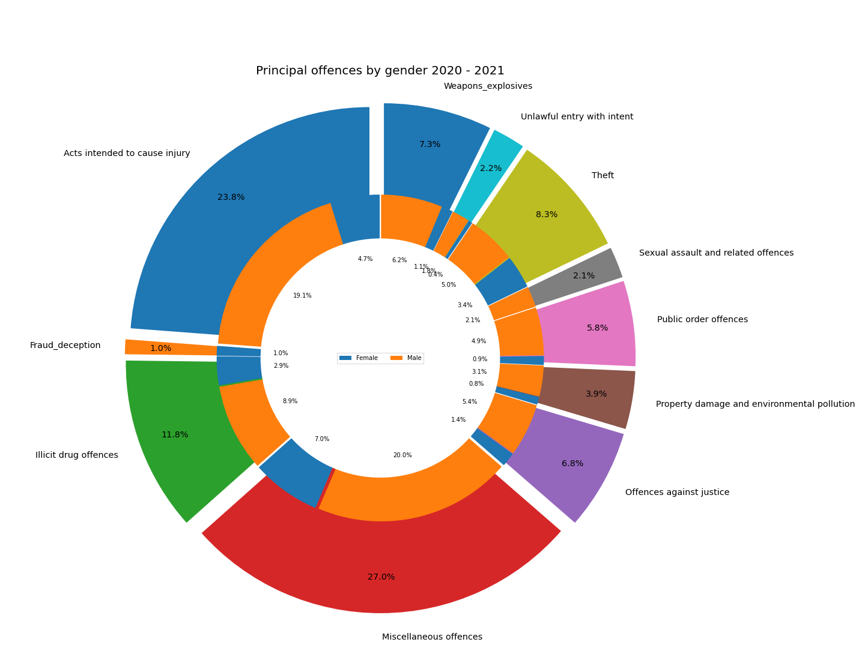
Principal offence by 2020 - 2021
Key findings:
Male contribute to 75% of the overall gender count
Acts intended to cause injury top 23%
Fraud & Deception are more common for female
Sexual assault and related offences are more common amongst male

Slide 13
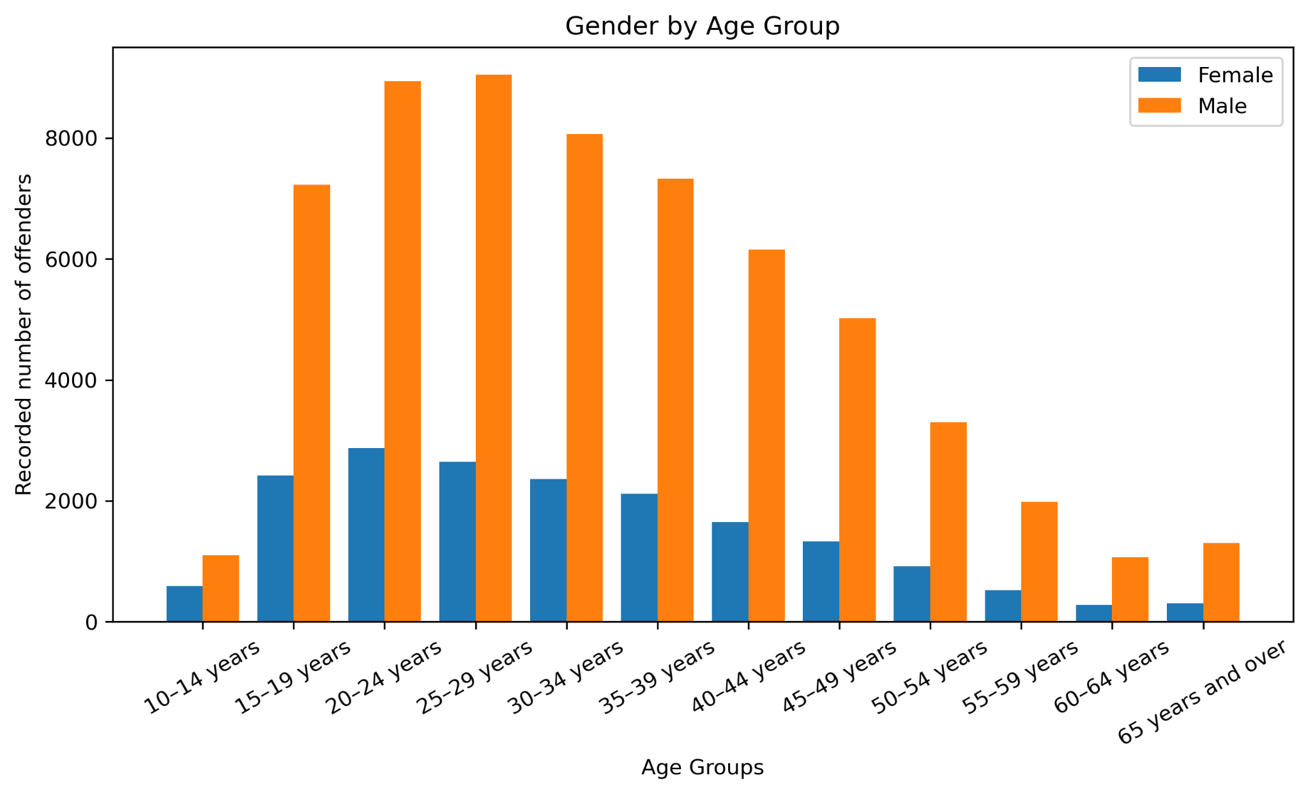
Offender’s Gender by Age Group
Majority Age Group:
Male
20 - 34 years old
Female
15 - 24 years old

Slide 14
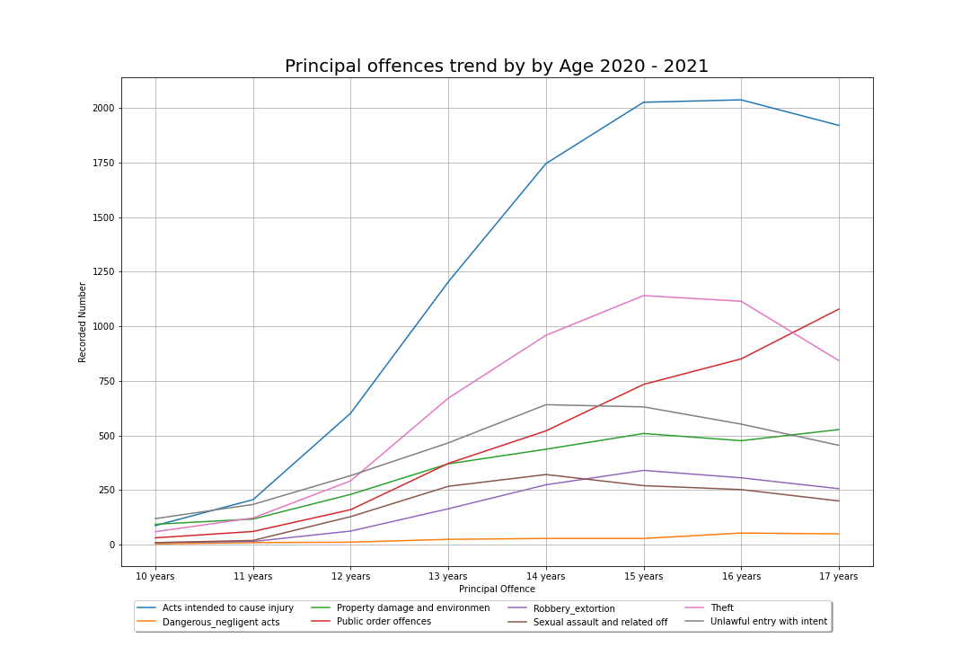
Offence Trends by Age (Youth) 2020 - 2021
Youth aged 15 years (23.79%) and 16 years (21.41%), make up 42.77% offenders for Robbery & Extortion in Victoria

Slide 15
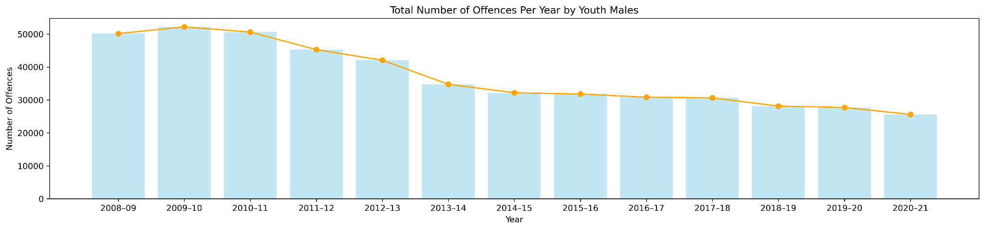
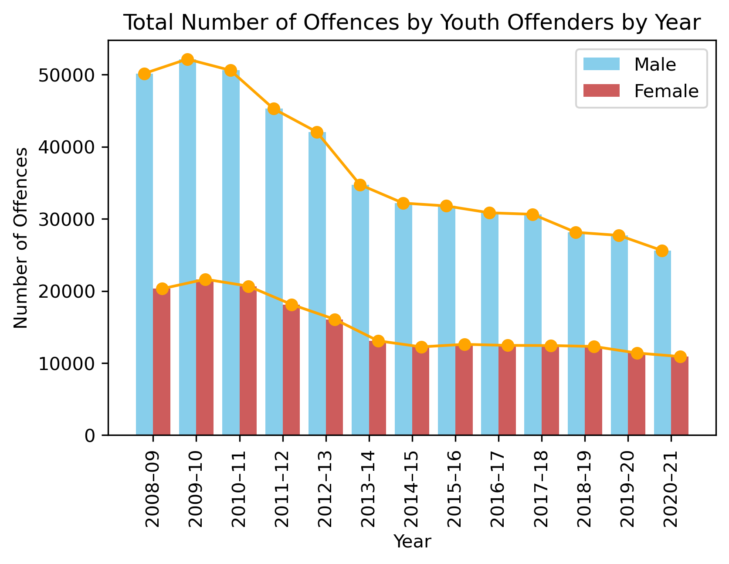
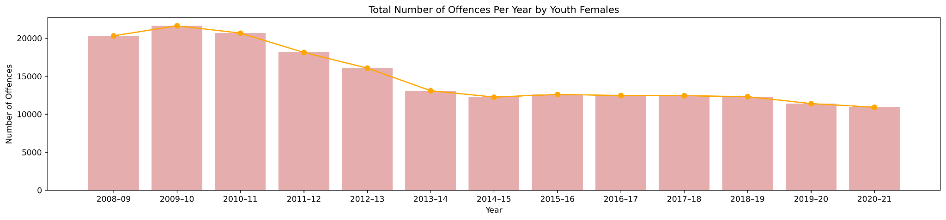
Youth Offenders Key Insights
Overall, male youth commit more offences than female youth.
Both gender groups have seen a overall decline in the total number of offences, over the years.

Slide 16
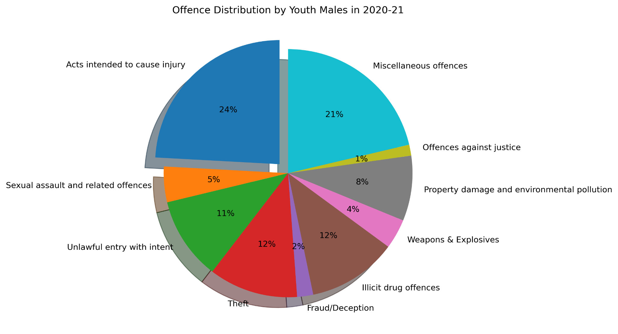
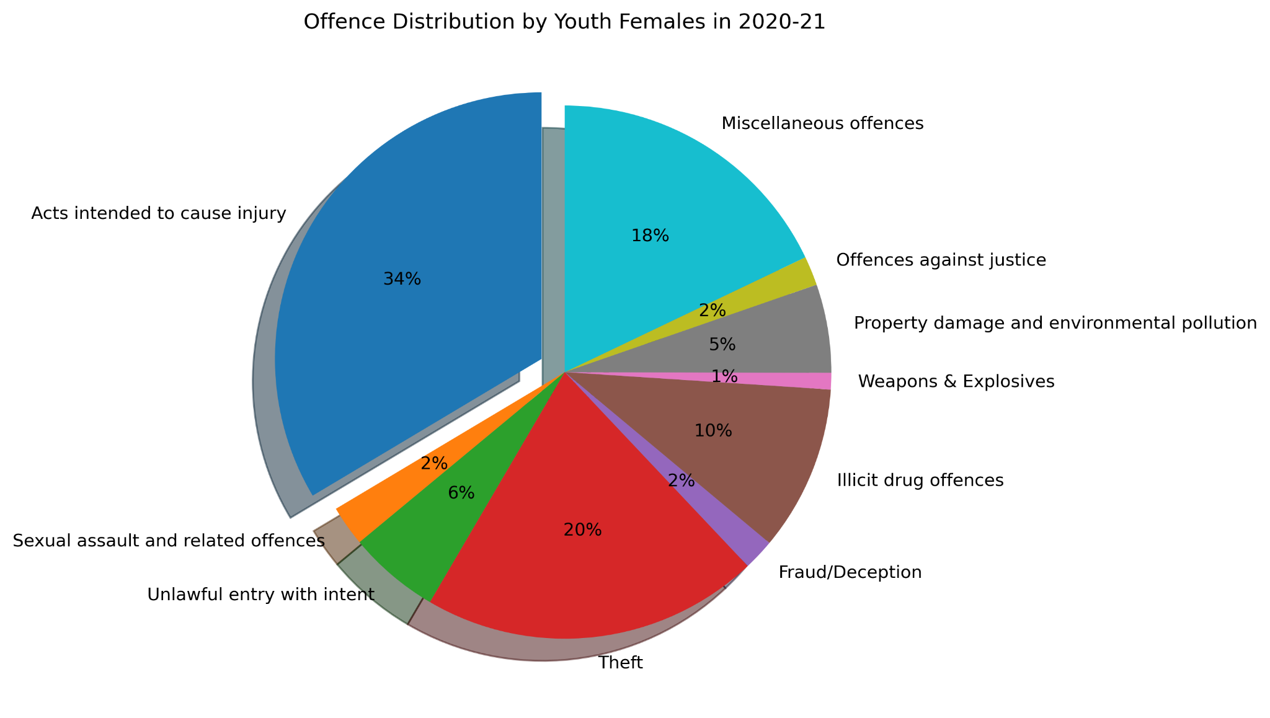
Youth Offenders Key Insights
Acts intended to cause injury was the leading offence among youth offenders in 2020-2021, across both gender groups, with females having a higher percentage (24% vs. 34%).
Among offence types, this was followed by miscellaneous offences, theft, and illicit drug offences.

Slide 17
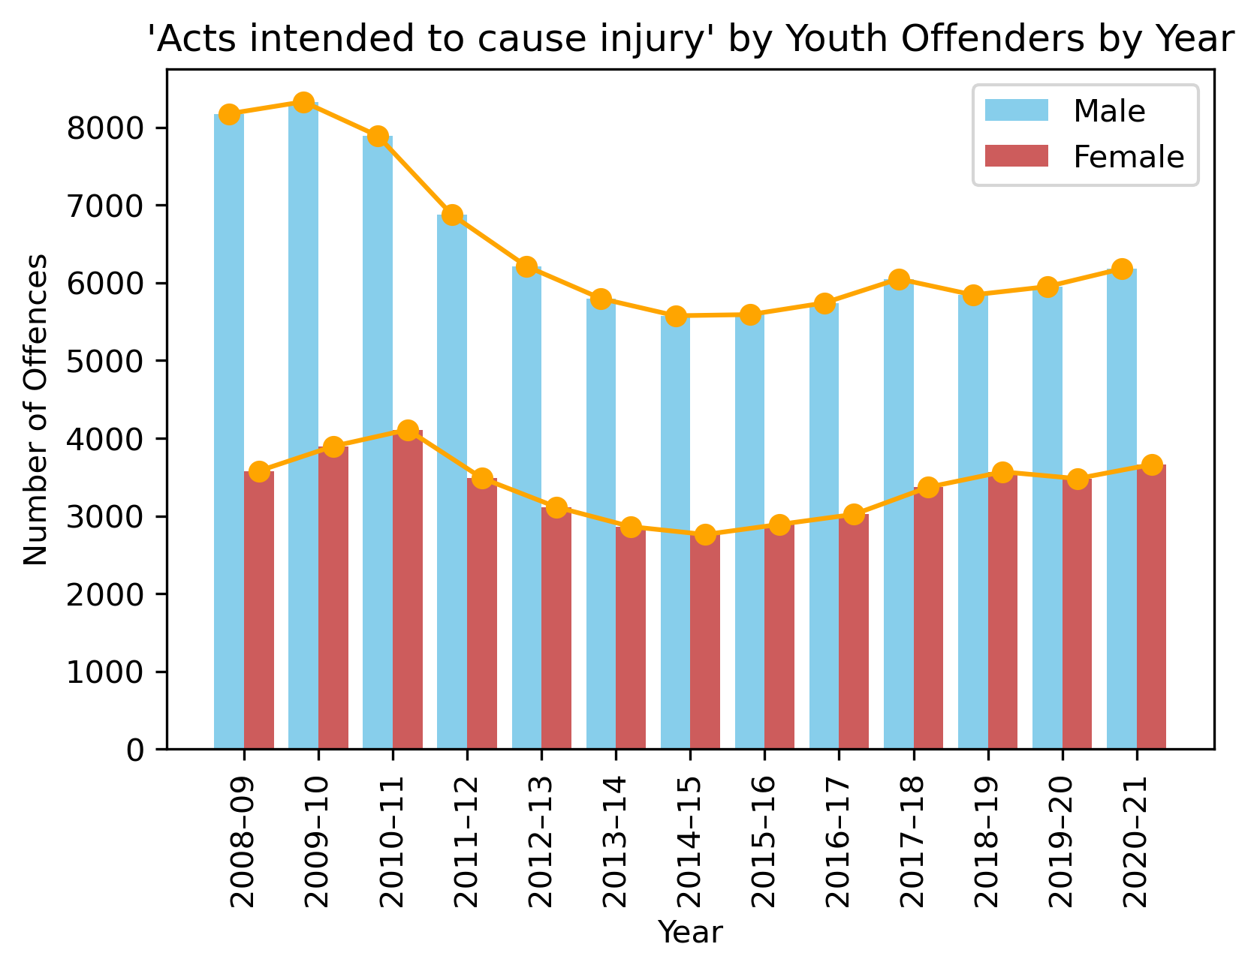
Youth Offenders Key Insights
From 2009 -2015, ‘Act intended to cause injury’ offences by male youth saw a decline and has remained steady until 2020-21.
Female youth ‘Acts intended to cause injury’ offence has remained steady in the past 13 years.

Slide 18
Limitations of the dataset
LGA data is skewed towards population size.
Data provided by the ABS does not include: organisation crimes, persons less than 10 years of age, indigenous status data, breach of bail, and family violence.
Offenders data does not show a true offence count as an offender is only counted once, irrespective of the number of offences committed during the reference period.

Slide 19
Conclusion
The 2020 to 2021 time period saw a large spike in public health crime as the result of the COVID-19 pandemic.
The most common type of crime recorded across Victoria was property and deception (including property damage, arson, burglary, deception, bribery). Resources by LGAs need to be focused towards security for properties, motor vehicles, law enforcement and emergency services.
Youths from the age of 15-16 makeup 42.77% of offenders for Robbery & Extortion in Victoria, while ‘acts intended to cause injury ‘ has remained the highest count youth offence type. Suggestions to approach the problem include: (1) further education into crime and its consequences, (2) enforcement of laws and regulations, and (3) increasing security e.g. CCTV.

